Slide 1
Problem Statement
PROBLEM STATEMENT NO :012
PROBLEM STATEMENT NAME:KNOELEDGE REPRESENTATION AND INSIGHT GENERATION FROM STRUCTURED DATASET
Marketing Effectiveness: "Despite heavy investments in marketing campaigns, many movies struggle to achieve box office success. How can studios improve the effectiveness of their marketing strategies to reach target audiences more efficiently?"

Slide 2
Unique Idea Brief (Solution)
KNOWLEDGE REPRESENTATION:-
The basic idea is to represent the knowledge base by collecting the data set and processed the data and load it in the Neo4j desktop.it will ceates the nodes between the entities and the relationship between them are connected .We will start the DBMS and query the Neo4j desktop site by using the cypher query and it will display the output by the nodes .it will display the relationshipamong the dataset.
INSIGHT GENERATION:-
Insight generation is the process of using the techiniques like data mining in data mining the clustering is used to describe the data in the data set.k-means clustering is used in the project to separate into clusters

Slide 3
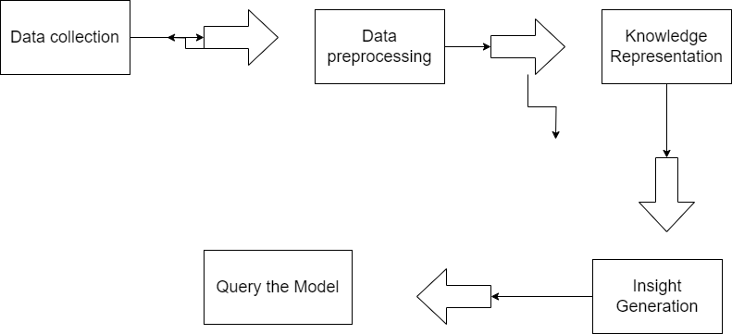
Process flow

Slide 4
Technologies used
Graph Databases: NEO4J
Graph databases are designed to store and query data using graph structures with nodes, edges, and properties. They are well-suited for representing complex relationships and performing graph-based analytics.
Unsupervised Learning: Used for clustering and anomaly detection to uncover patterns and relationships in data without labeled examples.

Slide 5
Team members and contribution:
INDIVIDUAL PARTICIPATION

Slide 6
Conclusion
Knowledge representation involves the systematic organization and structuring of information in a way that facilitates interpretation and reasoning by machines. Techniques such as graphs ,provide frameworks to capture complex relationships and concepts within data, enabling AI systems to navigate and utilize knowledge effectively.
Insight generation, on the other hand, goes beyond mere data processing to extract meaningful conclusions and actionable insights from structured datasets. It involves applying advanced analytics, statistical methods, and machine learning algorithms to uncover patterns, trends, correlations, or anomalies,and clustering.

